Slide 1
Air Quality Prediction for Major Cities of China
Jing Zhao
Capstone Project
Springboard Data Science
Oct, 2018

Slide 2
Air pollution Problem in China
Appears as thick haze and smog
PM2.5 (ultrafine particles < 2.5 microns in diameter) accountable for > 2/3 of the severely polluted days
Due to rapid industrialization and high energy consumption
Raises intense public concerns and media attentions
Emergence alerts and school shutdowns
Headlines of national and worldwide news
Puts a threat on human health
Linked to increased occurrence of various respiratory diseases (Asthma, Bronchitis, Lung Disease)
Number of hospital admission due to respiratory problems dramatically increased
Status
PM2.5 monitoring and reporting are introduced since 2013, and extended to 388 cities by 2015
Problem improves over the past five years, but still significant most days of the year

Slide 3
The Approach
Identify patterns of PM2.5
Trends (time-dependent, city-dependent, etc.)
Correlations to weather conditions (temperature, pressure, wind, precipitation, etc.)
Predict future PM2.5
Statistical models using StatsModels
Machine learning models using Scikit-Learn
Feature engineering to improve models

Slide 4
The Client
A PM2.5 predictive model is beneficial to people at all levels to reduce exposure to extremely polluted air
Government
Provide outdoor activity guideline for adults and children
Announce appropriate warnings in advance
Local organization
Plan outdoor events
Schedule emergency shutdowns
Individual citizen
Schedule commute choices
Plan daily outdoor activities
Wear personal protective equipment
Notes:
China started the PM2.5 monitoring and reporting program in major cities since early 2013, and has extended to 388 cities by 2015. In addition, PM2.5 data prior to 2013 are available from US embassy in major Chinese cities. However, besides live monitoring and reporting, understanding PM2.5 trends and building a PM2.5 prediction system are strongly desired. With predictions, government and citizens can plan ahead and take actions accordingly.

Slide 5
The Dataset
Source: Two public datasets hosted by UCI Machine Learning Repository
Link: https://archive.ics.uci.edu/ml/datasets/PM2.5+Data+of+Five+Chinese+Cities
https://archive.ics.uci.edu/ml/datasets/Beijing+PM2.5+Data
Dataset #1
Hourly PM2.5 readings for five Chinese cities (Beijing, Chengdu, Guangzhou, Shanghai, Shenyang)
Meteorological readings
(dew point, temperature, humidity, pressure, wind direction and speed, precipitation)
Period of 2010-2015
Dataset #2
Similar to dataset #1, but for city Beijing alone during the period of 2010-2014.
Precipitation is specified as ‘snow’ and ‘rain’
Notes:
In this project, we focus on the first dataset, but also taking into consideration the ‘cumulative hours of snow’ and ‘cumulative hours of rain’ for city Beijing from the second dataset.

Slide 6
Data Wrangling
Introduce new columns
‘date_time’: datetime format by parsing time-related columns 'year', 'month', 'day', 'hour'
‘pm_average’: the average pm2.5 level computed from multiple stations of the same city
‘ws’: hourly wind speed derived from the cumulated wind speed (‘iws’) in the raw data to eliminate artifacts
Divide into three subsets for different purposes
pm_clean: main dataset containing measurement data from all five cities, use ’pm_average’ as PM2.5 levels
pm_stations: supplementary dataset containing station-specific individual PM2.5 readings, only serving the purpose of validating measurement consistency among stations in each city pm_sr: side dataset containing information on cumulated hours of snows and rains for city 'beijing’, only serving the purpose of comparing the impact of snow versus rain on PM2.5
Missing & Outlier
Missing: 36% NaNs (93% of which is due to the missing pm2.5 values), dropped
Outlier: 0.025%, replaced when appropriate or dropped
Notes:
About the raw data: the raw data are downloaded as six separate CSV files, imported and concatenated as a single Pandas Dataframe. The concatenated raw dataset is composed of 306744 rows and 30 columns, containing a combination of time-related records and various measurements taken at multiple stations in each city for a total of five cities in China from year 2010 to 2015.
About missing data: There are a total of 36% rows containing missing data, 93% of which are due to the missing pm2.5 values. Given that pm2.5 (air quality indicator) is the main focus for the EDA and predictive modeling, records without valid pm2.5 values are of little use to this study. These missing data are dropped.
About ‘pm_average’: Hourly PM2.5 readings from multiple stations are recorded for each city in the raw data. The pm2.5 readings are reasonably consistent among stations in the same city and there's no reason to choose the PM2.5 reading from one station over others, therefore it's most representative to use the average PM2.5 readings in EDA and Modeling. A column 'pm_average' representing the average of pm2.5 readings from multiple stations of the same city is computed and used in the cleaned main dataset 'pm_clean' instead of the PM2.5 readings from individual station.
About ’ws’: The 'iws' column from the raw data records the cumulated wind speed over time, one of the meterological weather parameters. However the numbers in this column contain periodically reset to zero when wind direction alters, causing undesired artifacts. Therefore, it makes better sense to extract the hourly wind speed data ('ws') from cumulated wind speed ('iws') and use 'ws' for analysis and modeling instead of 'iws'.

Slide 7
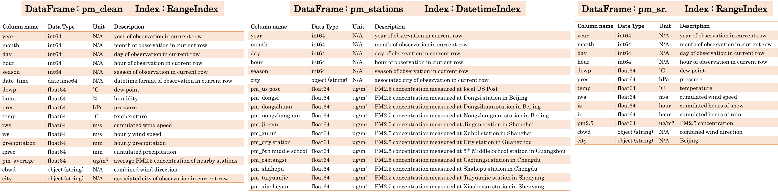
Cleaned Data

Slide 8
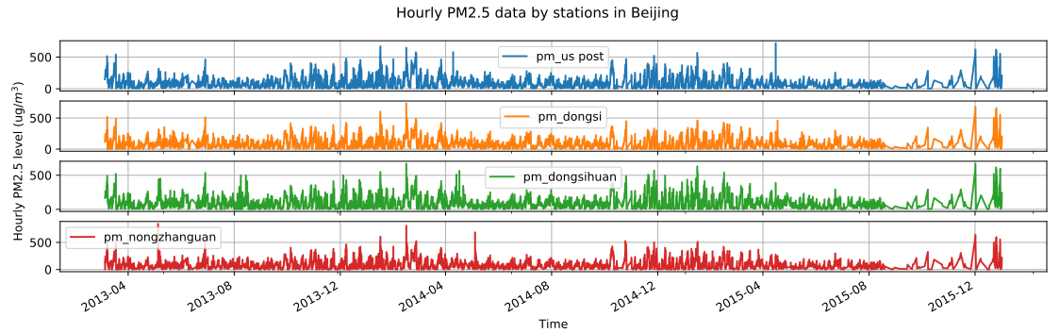
EDA - PM2.5 consistency across stations
PM2.5 measured at nearby stations are consistent with each other
The averaged PM2.5 is more representative and used hereafter
Notes:
First things first, the inter-station comparison are performed to verify the air quality measurement (PM2.5) consistency among stations in the same city. This consistency check lays the foundation for utilizing the station-average PM2.5 levels instead of the station-specific PM2.5 readings in all other EDA and modeling. The inter-station comparison for city Beijing is shown as an example, while comparison results for the other four cities are fairly consistent as well.

Slide 9
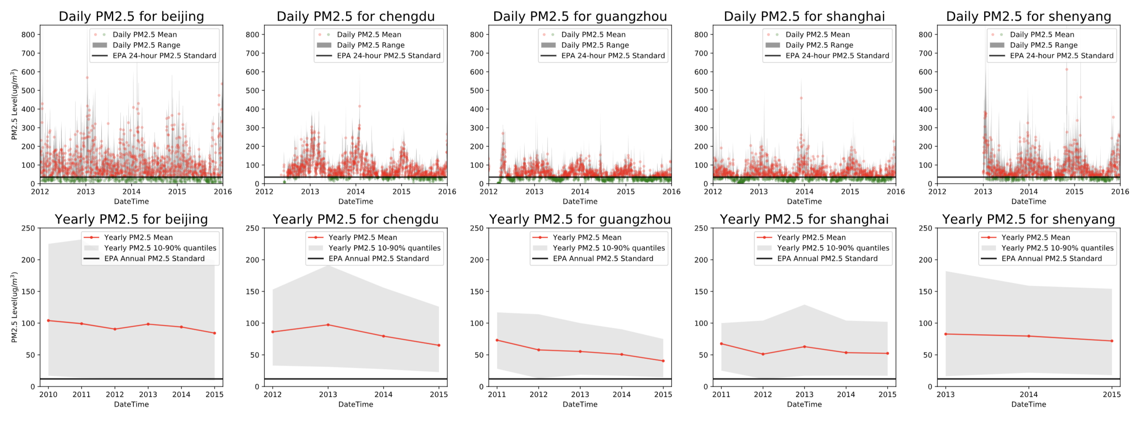
EDA - how bad is it ?
All five cities fail to meet the EPA standards:
Most daily average PM2.5 exceeds EPA recommendation for 24-hour PM2.5 level (35 μg/m³)
None of the annual PM2.5 levels meet EPA guidance for annual PM2.5 level (12 μg/m³)
Notes:
As the above comparison shows, all five cities fail to meet the EPA standards:
Most of the daily average PM2.5 levels (data points in red) exceeds the EPA recommendation for 24-hour PM2.5 level;
None of the annual PM2.5 levels meet the EPA guidance for annual PM2.5 level, not even the yearly minimum PM2.5 levels;
This reveals the truly problematic air conditions in densely populated cities of China. PM2.5 levels are too high to be considered healthy and safe according to EPA standards. Although actions and regulations have been taken to address the problem, the impacts are still far from satisfactory. In fact, as the data implies, although PM2.5 levels are gradually improving over time in all five cities, the progress can only be considered moderate. Learning from the data and history (lessons from London, Los Angeles, etc.), the problem takes years and efforts from all levels to resolve.

Slide 10
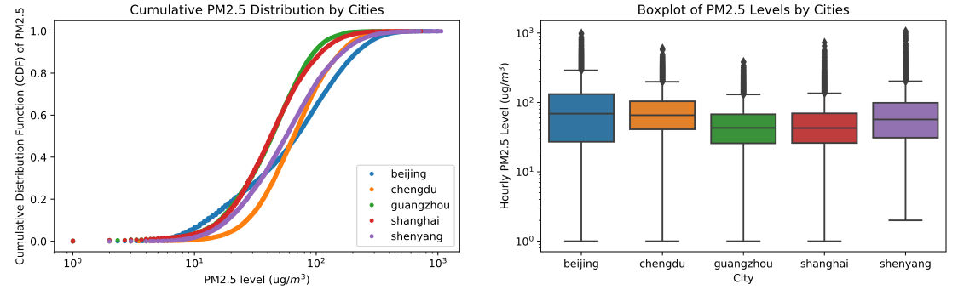
EDA – Cross-city Comparison
Air quality ranking (best → worst): Guangzhou, Shanghai, Chengdu/Shenyang, Beijing
Five cities all have distinct non-overlapping PM2.5 spikes, as a result of unique local environment
Five cities share similar time trends:
higher PM2.5 with larger fluctuations in winter, and lower PM2.5 with smaller fluctuations in summers
Notes:
Guangzhou has the most consistent low PM2.5 levels and the fewest days of high PM2.5 levels, whereas Beijing has the highest average PM2.5 levels and the widest spread of PM2.5 readings;

Slide 11
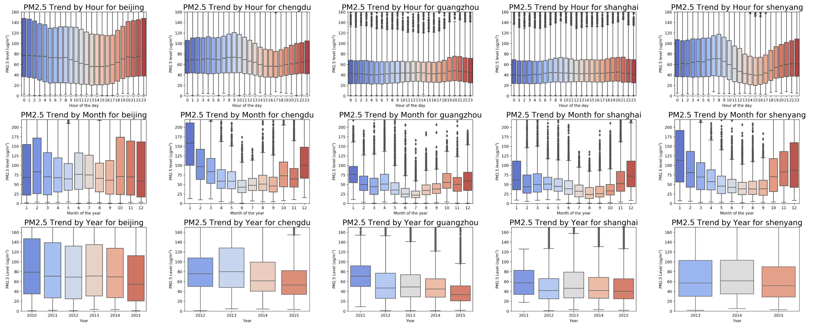
EDA - Trends over Time
Beijing Chengdu Guangzhou Shanghai Shenyang
Hourly:
Monthly:
Yearly:
Notes:
The hourly trends follow two distinct patterns corresponding to their unique physical locations
Beijing, Chengdu, Shenyang (inland cities): larger fluctuations during the 24-hour period; PM2.5 levels rise slightly during morning rush hours, then drop down afterwards; The readings reach the lowest in the afternoon, followed by a bound back during evening hours, and remain high throughout the night;
Shanghai, Guangzhou (coastal cities): only minor fluctuations during the 24-hour period; PM2.5 levels remain relatively low throughout the day, with only minor increases during evening hours;
The monthly trends demonstrate similar patterns:
All five cities share somewhat similar variations around the year, with larger fluctuation (quantile ranges) in winter months and smaller fluctuation in summer months.
PM2.5 starts to drop during spring months, reaches the lowest during summer months, begins to bound up during fall months and rapidly reaches the highest during winter months. In general, the median PM2.5 levels in winter months are at least twice as high as that of summer months, except for city Beijing where PM2.5 levels demonstrate a minor irregular change from month to month.
The yearly trends reveal a gradual improvement over time:
PM2.5 levels follow downward trends in all five cities, indicative of a gradual improvement in air quality over time
In addition:
Day-of-the-week and seasonal trends are not shown, as day-of-the-week trends show only minor fluctuations with no clear trend and no difference between weekdays and weekends, and Seasonal trends are fairly consistent with monthly trends.

Slide 12
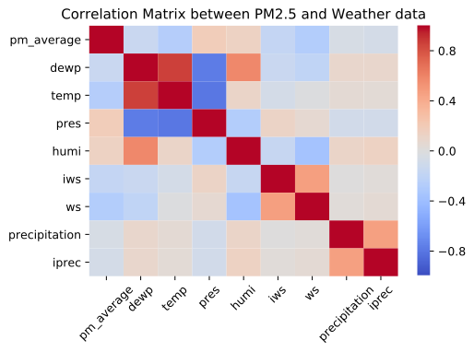
EDA – Correlation Matrix with Weather
Correlation with PM2.5
temperature: negative
dew point: negative
wind speed: negative
precipitation: negative
pressure: positive
humidity: positive

Slide 13
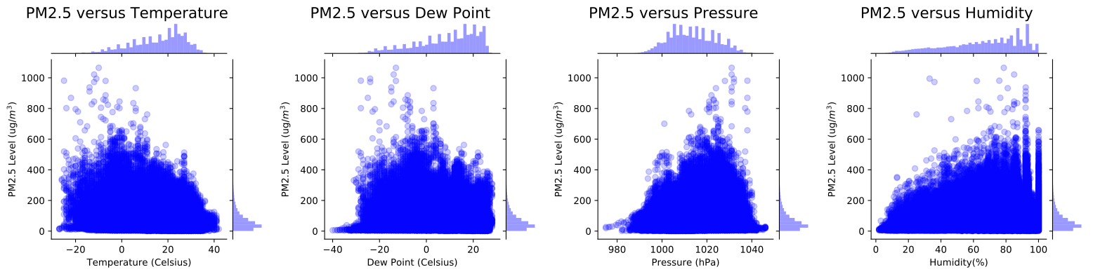
EDA – A Closer Look at Correlation (Temperature, Dew point, Pressure, Humidity)
PM2.5 vs. Temperature PM2.5 vs. Dew Point PM2.5 vs. Pressure PM2.5 vs. Humidity
Temperature: negative correlation, higher PM2.5 mostly associated with T < 10°C (cold weather) Dew point: negative correlation, higher PM2.5 mostly associated with T < 5°C Pressure: positive correlation, higher PM2.5 mostly associated with higher atmospheric pressures.
Humidity: weak positive correlation (statistically significant), higher PM2.5 more likely to occur at higher humidity
Notes:
The correlation between PM2.5 and dew point is similar to that between PM2.5 and temperature, this is expected as dew point and temperature are strongly positively correlated.
The correlation between PM2.5 and pressure is opposite to that between PM2.5 and temperature, this is also expected as pressure and temperature are negatively correlated.

Slide 14
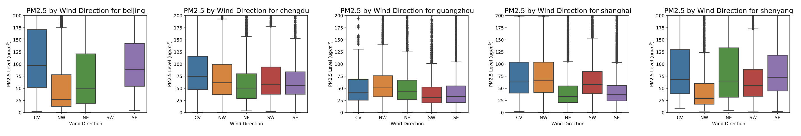
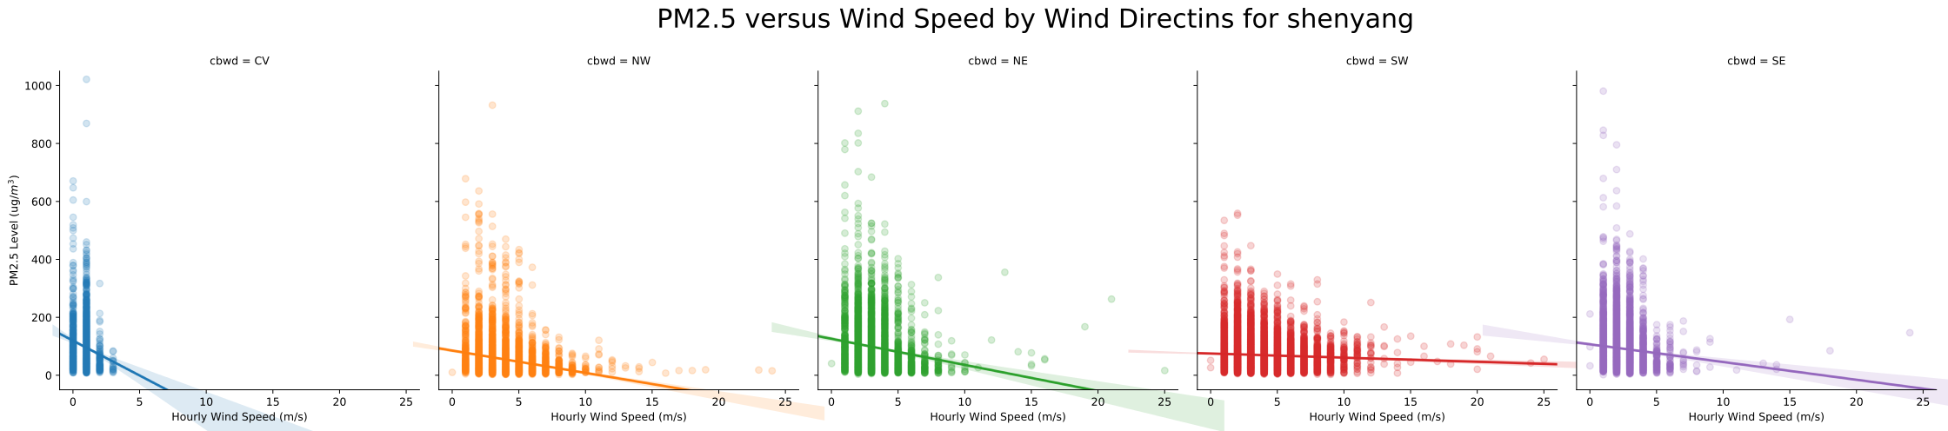
EDA – A Closer Look at Correlation (Wind)
Wind Direction¹
Strong dependency on direction
Dependence differs by city:
location, neighbor environment
¹ northwest(NW), northeast(NE), southeast(SE), southwest (SW), static wind (CV)
Wind Speed
Higher speed reduces PM2.5:
all directions, all cities
Direction with higher speed:
smaller PM2.5 median value
narrows inter-quantile range
Direction with stronger correlation:
broader inter-quantile range
low speed
higher speed
stronger correlation
higher speed
stronger correlation
Notes:
The correlation between PM2.5 and wind speed is complicated by the dependency on city and wind direction:
Beijing: winds from northwest are the strongest, while winds from northeast are most effective at reducing high PM2.5 levels;
Chengdu: winds from northeast are the strongest, while winds from southwest are most effective at reducing high PM2.5 levels;
Guangzhou: winds from the north (NE, NW) are stronger. Although higher wind speeds also help to reduce PM2.5, the effect is very limited;
Shanghai: winds from the east (NE, SE) are stronger, while winds from southwest are most effective at reducing high PM2.5 levels;
Shenyang: winds from the west (NW, SW) are stronger, while winds from the east (NE, SE) are more effective at reducing PM2.5 levels.
Despite the complication, there are some common characteristics shared by all cities:
Higher wind speeds help to reduce PM2.5 levels, this has been observed with all wind directions in all cities;
Static winds feature low wind speeds (<5 m/s), therefore they have limited effect on reducing PM2.5 levels;
The wind direction with higher wind speeds has smaller PM2.5 median value and interquantile values;
The wind direction with a stronger correlation between wind speed and PM2.5 has broader PM2.5 interquantile ranges, this is true because PM2.5 level varies more with wind speed and causes wider distribution of PM2.5;

Slide 15
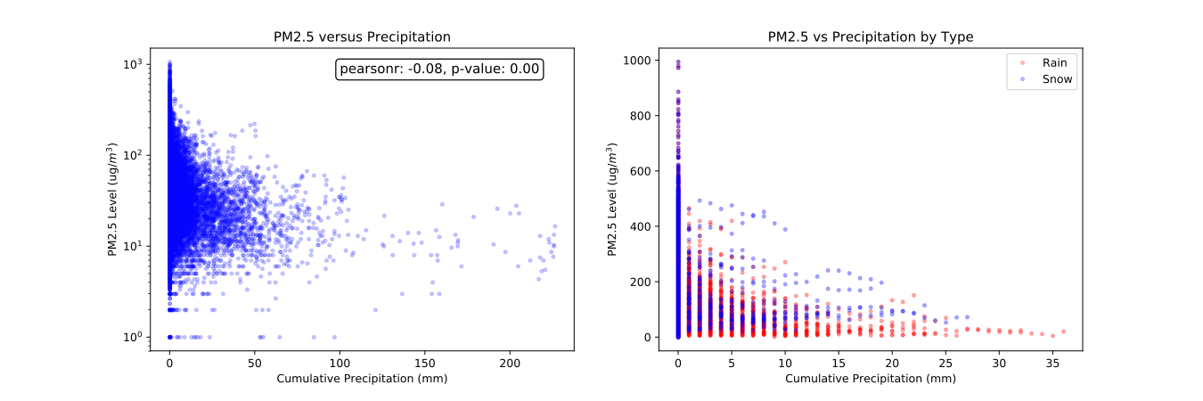
EDA – A Closer Look at Correlation (Precipitation)
Precipitation reduces high PM2.5 levels regardless of the type
Rain is slightly more effective at reducing PM2.5 than snow
Large or extended periods of precipitation (high cumulative precipitation)
very effective at eliminating high PM2.5 (>100)
only very limited impact for low PM2.5 (< 50)

Slide 16
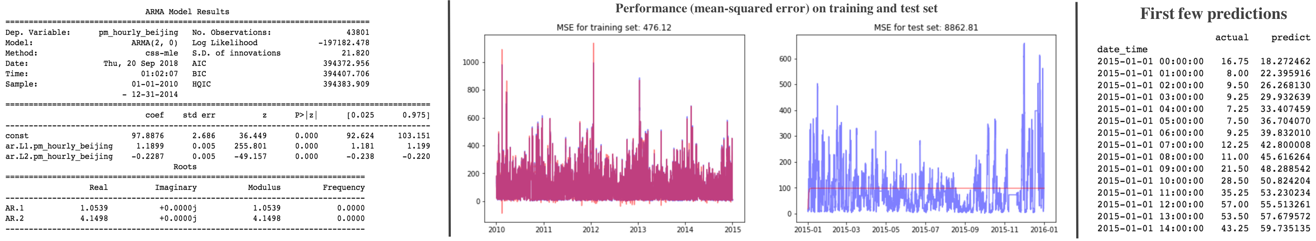
Modeling – Time Series by ARIMA/SARIMA
Time series PM2.5 by itself (without the weather features) is first modeled using ARIMA/SARIMA from StatsModels
Training set: year 2010-2014; Test set: year 2015; Optimization: grid search
Acceptable performance on training sets
Reasonable precision for the very first out-of-sample prediction into the future
Poor predictions for further steps into the future
Time series alone is not enough
Other underlying factors!
Notes:
The following procedures are performed to construct the ARIMA-based models for each city:
Dickey-Fuller Test is first conducted to determine if the time series of interest is stationary, the resulting p-value is very small (essentially zero), suggesting that the time series is already stationarity
ACF and PACF plots are then graphed to identify the potential parameters to use (p,d,q,(s)) for building ARIMA and SARIMA models.
Grid search results show that ARIMA models of various combinations of p,d,q share very similar performance
ARIMA model is constructed using the best combination of p, d, q identified for each city
Model is trained on data of year 2010-2014 and tested on data of year 2015.
In addition, SARIMA model is also carried out to best account for the observed seasonal component (yearly). Again, the resulting SARIMA model only provides a reasonable prediction for the very first data point into the future, but fails to predict further steps.

Slide 17
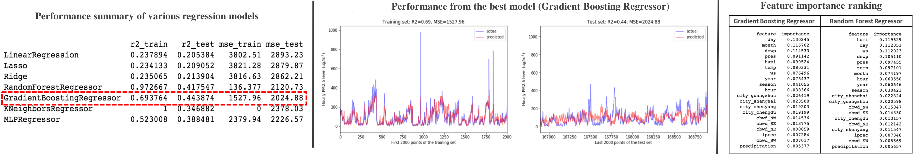
Modeling – Datetime + Weather Feature
Machine learning regression models are constructed by incorporating weather data with datetime data:
Datetime feature: year, month, day, hour, season; Weather feature: wind speed, temperature, humidity, etc.
Training set: year 2010-2014; Test set: year 2015; Optimization: grid search
Gradient Boosting Regressor performs the best among all regressors: R² = 0.44 (holdout set)
Important meteorological weather feature: wind speed, temperature, humidity, dew point, pressure
Important datetime feature: month, day
Separate models for individual cities: R² up to 0.45-0.5
Feature engineering is needed for additional improvement!
Notes:
Simple linear models (LinearRegression, Lasso and Ridge) only achieves R^2=0.21 on the test set.
Among non-linear models, KNeighborsRegressor gives R^2 of 0.34; ensemble methods, like RandomForestRegressor and GradientBoostingRegressor, achieve R^2 of 0.42-0.44; In addition, artificial neural network based MLPRegressor is also tried out with a reported R^2 of 0.39.
Of all regression models, Gradient Boosting Regressor produces the best performance on the holdout set, the performance of which is plotted in the middle of the above figure.
In addition, the feature importance rankings from the optimized Gradient Boosting Regressor and Random Forest Regressor are also shown in the above figure. Although the ranking varies slightly, the top seven features are consistent. These reveal that among all meteorological parameters, wind speed (ws), temperature (temp), humidity (humi), dew point (dewp) and pressure (pres) are the top influencers; among all datetime-related parameters, month and day are the most important factors.
In addition, separate machine learning models are attempted for individual cities. By separating out the 'city' feature into individual models, R^2 is improved from 0.4-0.45 to 0.45-0.5. But, further improvements are hard without additional feature engineering.
These suggest that although time-related information and weather conditions can only explain the variations in air quality (PM2.5 value) to a limited extent. There are other underlying reasons causing the PM2.5 trends and variations.

Slide 18
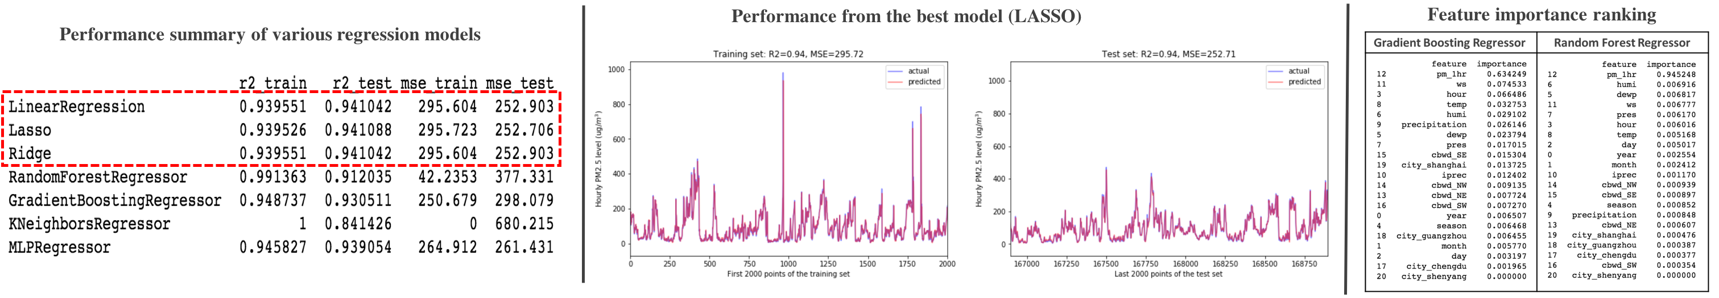
Modeling – Introduce Lag Feature
A lag feature (PM2.5 value from the last step) is included to accommodate its autoregressive nature (progress on prior value):
All previous regression models updated by adding the new lag feature
Train set: year 2010-2014 of four cities; Test set: year 2015 of four cities and all data of the fifth city (unseen city)
The introduction of lag feature is successful, R² scores → boosted significantly regardless of the model used
Simple linear models → R² = 0.94 (holdout set), more advanced models → no further improvement
Feature important: the new lag feature → > 60% of the contribution, weather feature → up to 25%, datetime → the rest
The winning model not only forecast into the future, but also extends to predict an unseen city.

Slide 19
Limitation and Future Work
Limitation of the Winning Model
Predicts limited steps:
requires values in the previous step for predicting future steps
error propagates as the prediction is used to forecast further steps
Pipeline setup:
log the forecasted PM2.5 values to enable predictions for further steps
Maintenance:
replace prediction with actual observation whenever available to reduce error
Other Potential Future Work
Ensembles of the above machine learning models to average out bias and improve performance
Downsampling on a daily frequency instead of using the hourly frequency

Slide 20
Summary
Hourly PM2.5 and weather data of five major Chinese cities in 2010-2015 are analyzed and modeled:
Patterns in PM2.5
Alters significantly among cities
air quality from best to worse are Guangzhou, Shanghai, Chengdu and Shenyang, Beijing
PM2.5 levels for all five cities are way too high to be considered healthy and safe
Varies systematically with time
daily & monthly trends are unique for individual cities
yearly trend shows consistent improvements over time
Correlates with meteorological weather data to some extent
high wind, large precipitation improve air quality in all cities
wind direction affects air quality, but the dependency differs by city
PM2.5 positively correlated to temperature/dew point, and negatively correlated to pressure/humidity
Modeling PM2.5
Historical value, datetime, weather condition all affect future PM2.5 values
Historical value → baseline of future PM2.5, weather condition + datetime → how future PM2.5 deviates from its past
The winning model achieves R² of 0.94 on the holdout set, not only forecasts future, but also extends to predict an unseen city
Notes:
Understanding and predicting air pollution have become increasingly important to people at all levels in China, due to the severe air problem in the past few years. Hourly PM2.5 data of five major Chinese cities in the period of 2010-2015 are acquired, analyzed and modeled in this study, to identify PM2.5 patterns and forecast future air quality.

Slide 21
Acknowledgement
Mentor: Max Sop
UCI Machine Learning repository
Springboard team

